Slide 1
Spam Filters
Team 2: Amanda Aird, Cindy Huang, Josh Hjelmaas

Slide 2

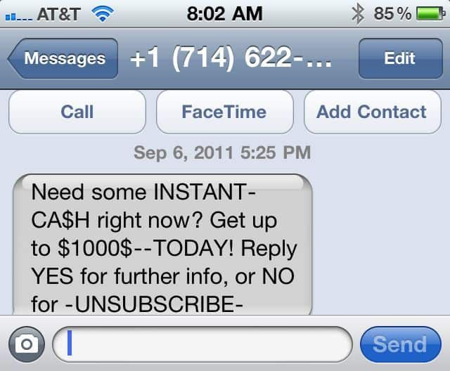

Slide 3




Spam or Ham?
Dataset
Evaluation Method
AUC score
Goal
Prediction of legitimacy of the message
containing SMS messages that are either "spam" messages or "ham" messages
This Photo by Unknown author is licensed under CC BY-SA.

Slide 4
Preprocessing
Summary of Predictive Features:
sentiment analysis to get TFIDF score and Count Vectorization score.
Description of Binary Outcome:
The binary outcome is if the message was “spam” or “ham” (legitimate).

Slide 5
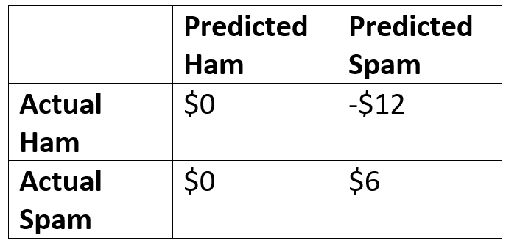
Profit Structure

Slide 6

Modeling Process

Slide 7
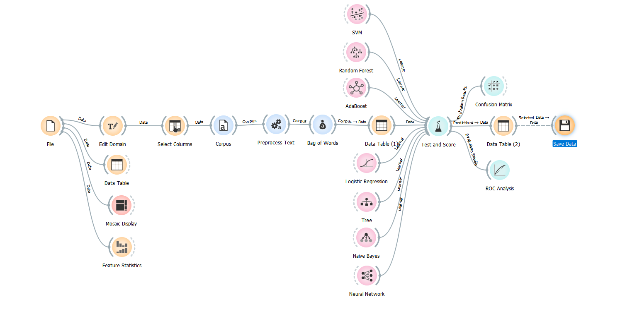
Model Process

Slide 8
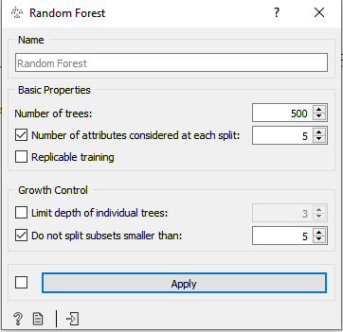
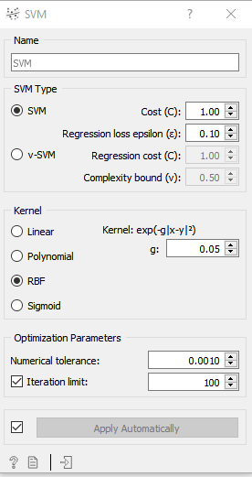
Models
SMV
AUC: 0.916
Random Forest
AUC: 0.992

Slide 9
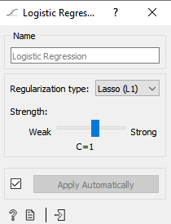
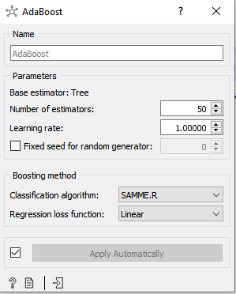
Models
AdaBoost
AUC: 0.917
Logistic Regression
AUC: 0.988

Slide 10
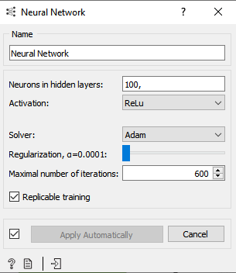
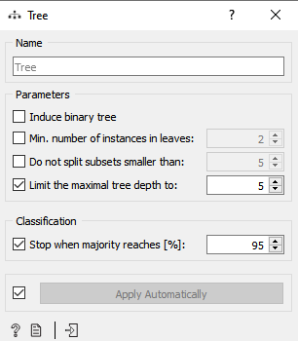
Models
Tree
AUC: 0.784
Naïve Bayes
AUC: 0.992
Neural Network
AUC: 0.959

Slide 11
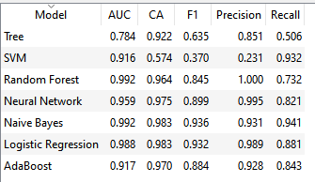
Model Results

Slide 12

Evaluation

Slide 13
Choosing the best Model
Naïve Bayes and Random Forest had identical AUC scores
We created performance plots for both models and used the profit curve as a tiebreaker

Slide 14
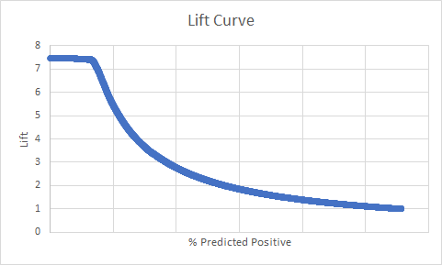
Naïve Bayes

Slide 15

Random Forest

Slide 16
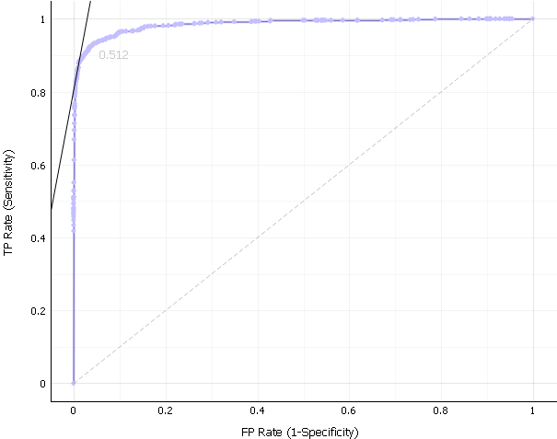
Naïve Bayes
ROC Curve

Slide 17
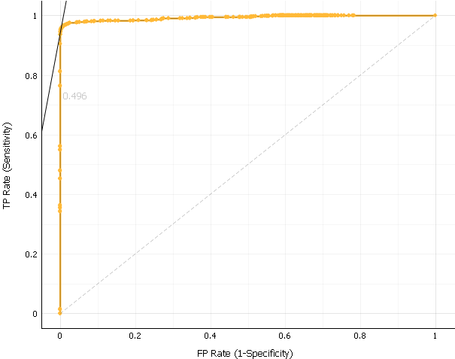
Random Forest
ROC Curve

Slide 18
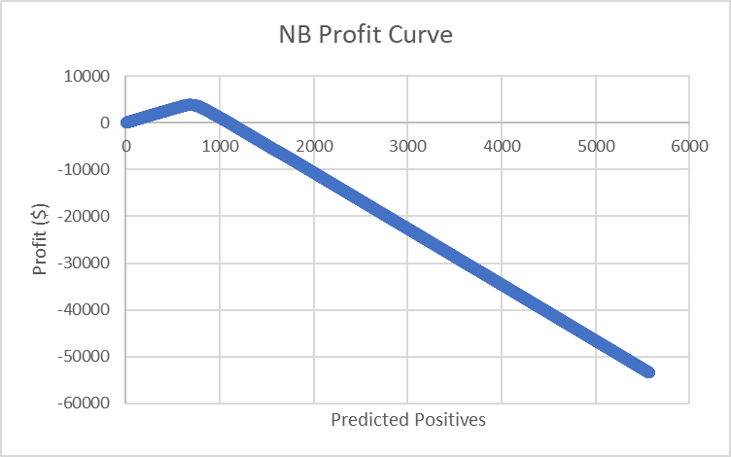
Naïve Bayes
Maximum profit: $3,804 at 0.9042 threshold

Slide 19

Random Forest
Maximum profit: $4,110 at 0.1996 threshold

Slide 20

Recommendation

Slide 21
Recommendation
Random Forest
Threshold: .1996
Profit: $4,110 in sample set
Notes:
Chosen model: random forest,
recommend a threshold for random forest (based off profit curve): 19.92 % with a profit of $4110

Slide 22
Thank You

